Slide 1
Heat Transfer

Slide 2
Definition
  Heat transfer is energy in transit due to a temperature difference. (OR)
  Heat transfer is energy transfer due to a temperature difference in a medium or between two or more media
Different types of heat transfer processes are called different modes of heat transfer
Conduction heat transfer is due to a temperature gradient in a stationary medium or media
Convection heat transfer occurs between a surface and a moving fluid when they are at different temperatures
Radiation heat transfer occurs due to emission of energy in the form of electromagnetic waves by all bodies above absolute zero temperature
  Net radiation heat transfer occurs when there exists a temperature difference between two or more surfaces emitting radiation energy

Slide 3
Heat Transfer Applications
Heat transfer is important to Industrial and Environmental problems and processes
All Energy production and conversion processes involve heat transfer
In electric power generation, heat transfer problems must be solved
In some applications, heat transfer rate is maximized (heating) while in other cases it is minimized (cooling)

Slide 4
Thermodynamics, Fluid Mechanics and Heat Transfer
  Thermodynamics
    Concerns initial and final states (not the process)
    1st law of thermodynamics ⇒ energy conservation
    2nd law ⇒ direction of energy transport
    But does not provide information on the nature of the process or the rate at which energy is transferred
  Fluid mechanics ⇒ rate of momentum transport
    Momentum in transit due to velocity gradient
  Heat transfer⇒ rate of thermal energy transport
    Energy in transit due to temperature gradient
  Energy transfer rates are important in engineering process design and development

Slide 5



Symbols and units
Thermal energy: E=[J]
Heat transfer rate: q=[W]=[J/s]
Heat transfer rate per unit length q/L=[W/m]
Heat transfer rate per unit area q/A= [W/m²]
Temperature: T=[ºC] or [K] T(K)=T(ºC)+273.15
Note: When ºC or K unit is in the denominator, unit change doesn't affect the numerical value, e.g., specific heat Cp 1 J/kg^{.o}C=1 J/kg.K, thermal conductivity 1 W/m^{.o}C=1 W/m.K

Slide 6
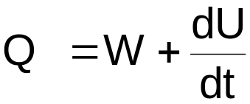
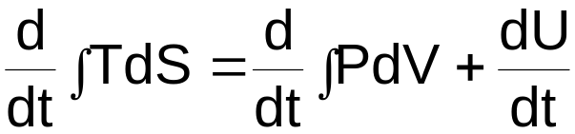
Introductory Heat Transfer Concepts
Relationship of heat transfer to thermodynamics
Heat transfer = work + rate of change of internal energy
For a thermodynamic reversible process,
where:
T = temperature S = entropy
P = pressure V = volume
U = internal energy t = time

Slide 7
Since all heat transfer processes are irreversible and S cannot be defined as a function of T, the rate of heat transfer Q, cannot be predicted by the above thermodynamic equation.
  We must therefore use transport laws, i.e.
    Fourier’s Law
    Newton’s law of cooling, and
    Stefan Boltzmann law
Heat transfer is indeed applied thermodynamics
Heat transfer is energy transfer as a result of a temperature difference

Slide 8
Modes of Heat Transfer
There are three basic modes of heat transfer
  Conduction
  Convection
  Radiation
We will first examine all three modes briefly

Slide 9
Conduction
Conduction heat transfer is due to random molecular and atomic vibrational, rotational and translational motions
  High temperature and more energetic molecules vibrate more and transfer energy to less energetic particles as a result of molecular collisions or interactions
The heat flux q_{x}´´ (W / m²)
is characterized by a transport property know as the
  Thermal Conductivity, k (W / m · K)
  W = watts m = Meters K = temperature in Kelvin

Slide 10
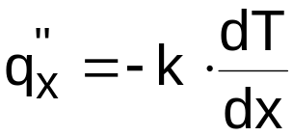
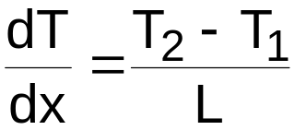
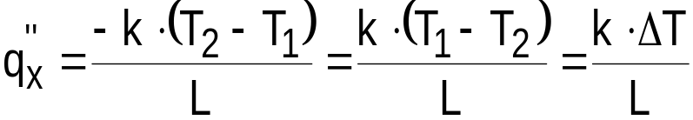
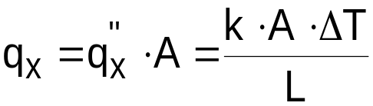
Consider the heat flux through a slab of thickness, L
L
T₁
T₁
T₂
q_{x}´´
T₂
X=0
X=L
x
0
L
For the one-dimensional plane, the heat flux or heat transfer rate is Fourier’s Law:
The total heat transfer through a given cross-sectional area, A, is given by:
where

Slide 11
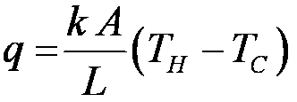

Conduction Resistances
L
The analysis of conduction within simple geometries can be concisely summarized in the form of thermal resistances
For example, the analysis of 1-D, steady state conduction through a plane wall leads to:
T_{H}
T_{C}
A
T_{H}
T_{C}

Slide 12
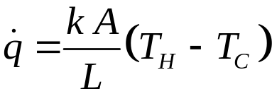
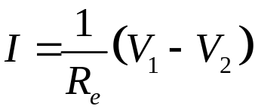

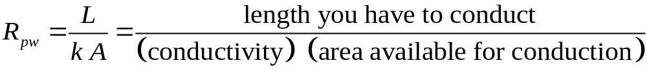
Resistance Concept
Heat Transfer
Ohm’s Law
heat transfer
temperature difference
current
voltage difference
(thermal resistance)⁻¹
electrical resistance
where R_{pw} is the thermal resistance associated with conduction through a plane wall:

Slide 13
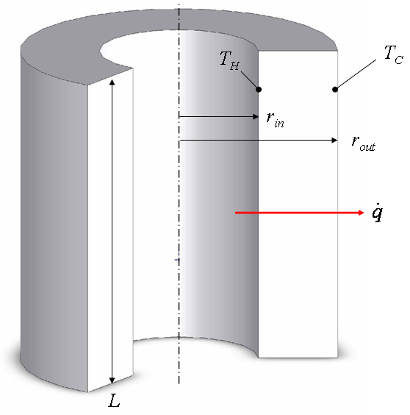
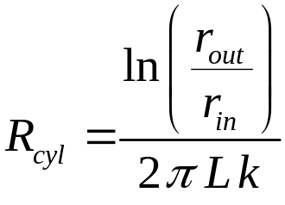

Conduction through Other Shapes
where

Slide 14
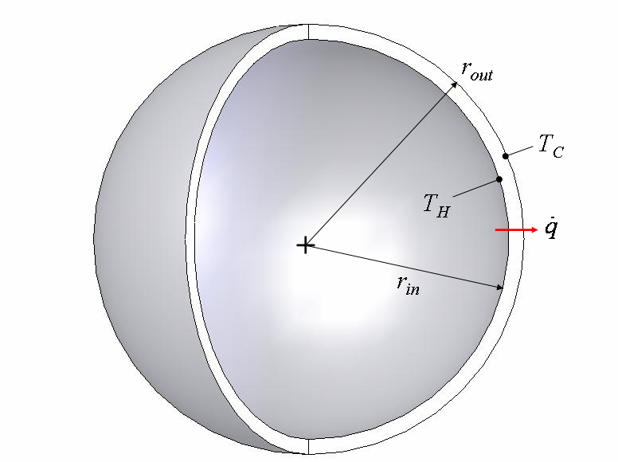

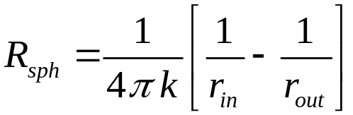
Conduction through Other Shapes
where

Slide 15

Convection
Convection heat transfer involves both energy transfer due to random molecular motions and by bulk motion of the fluid
  Convection heat transfer includes both forced convection and natural convection
In convection heat transfer, the transfer of heat is between a surface and a moving fluid (liquid or gas), when they are at different temperatures. The rate of transfer is given by Newton’s Law of Cooling.
T∞
q’’
Moving fluid
T_{s}
T_{s} > T∞

Slide 16



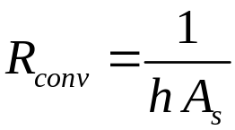
Convection Resistance
fluid temperature = T_{f}
surface temperature = T_{s}
Newton’s law of cooling:
heat transfer
temperature difference
(thermal resistance)⁻¹
where R_{conv} is the thermal resistance associated with convection:

Slide 17
Typical values of convection heat transfer coefficient
Process | h (W / m² K)
Free Convection
Gases | 2 -25
Liquids | 50 -1000
Forced Convection
Gases | 35 -250
Liquids | 50 -20,000
with Phase Change
Boiling or Condensation | 2500 -100,000

Slide 18

Radiation
All surfaces of finite temperature emit energy in the form of electromagnetic waves
In the absence of an intervening medium, there is a heat transfer by radiation between two surfaces at different temperatures
The maximum flux, E (W / m2), at which radiation may be emitted from a blackbody surface is given by:
  Stefan Boltzmann Law
  where
  E_{b} or E = Surface emissive power (W / m²)
  T = absolute temperature (K)
  σ = Stefan-Boltzmann constant = 5.67 x 10⁻⁸ (W / m² ּ K⁴)
E_{b}
T_{s}

Slide 19
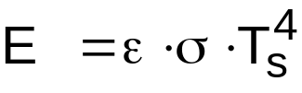

For a real surface:
For a surface with absorptivity α, the incident radiation (G, W/m2) or surface irradiation from the surroundings that is absorbed by the surface is given by:
where
G = incident radiation (W / m2)
T = absolute temperature (K)
ε = surface emissivity (0 ≤ ε ≤ 1)
α = surface absorptivity (0 ≤ α ≤ 1)
G
G_{abs}

Slide 20
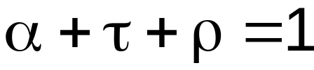
For a gray surface α = ε
When radiant energy is incident on a transparent surface, it can be absorbed, reflected, or transmitted through the material. Hence,
where
ρ = materials surface reflectivity
τ = materials transmissivity

Slide 21

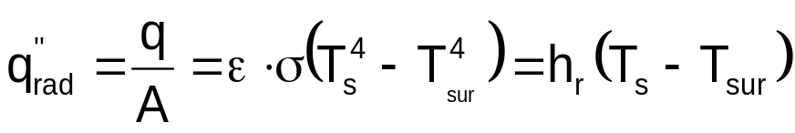
Consider a small gray surface at temperature Ts that is completely enclosed by the surroundings at temperature T_{sur}.
The net rate of radiation heat transfer from the surface is:
Where h_{r} is the radiation heat transfer coefficient, W / m² K
T_{sur}
q_{sur}’’
q_{s}’’
T_{s}

Slide 22
Representative range of radiation heat transfer coefficient values
h_{r} (W / m² K) | ε = 0.1 | ε = 0.5 | ε = 0.9
T_{s} = T_{sur} = 300K | 0.6 | 3.1 | 5.5
T_{s} = T_{sur} = 500K | 2.8 | 14.2 | 25.3
T_{s} = T_{sur} = 800K | 11.6 | 58.0 | 104.4
T_{s} = 300K T_{sur} = 500K | 1.5 | 7.7 | 13.9
T_{s} = 300K T_{sur} = 800K | 4.6 | 22.8 | 41.0

Slide 23




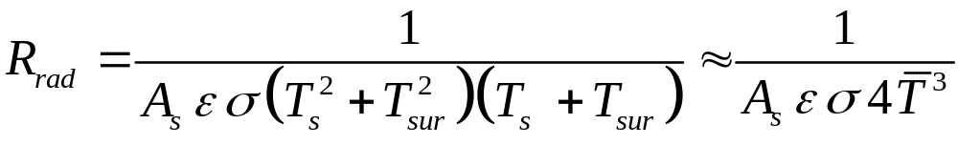
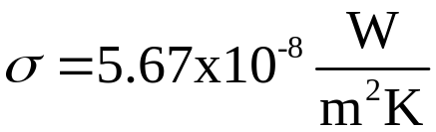
Radiation Resistance
surrounding surfaces at temperature = T_{sur}
surface emissivity, ε
surface temperature = T_{s}
heat transfer
temperature difference
(thermal resistance)⁻¹
where R_{rad} is the thermal resistance associated with radiation:

Slide 24
Introduction to Conduction, Thermal Properties

Slide 25
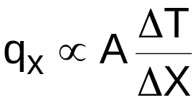
CONDUCTION HEAT TRANSFER
Conduction Rate Equation
  Fourier’s Law was based on experimental investigation in which it was shown that for a rod of length ΔX and cross-sectional area A with the lateral surface insulated and the ends having a temperature gradient ΔT, the conduction heat rate q is proportional to A, ΔT and ΔX. That is,
A, T₁
T₂
q_{x}
x
Δx

Slide 26
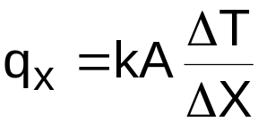
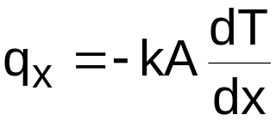
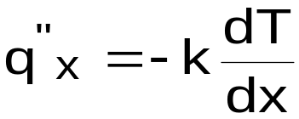
The proportionality constant k (thermal conductivity, W/m K) is an important property of the material. Thus,
In the limit ΔX → 0, we obtain for the heat rate
or for the heat flux:
The minus is used because heat is transferred in the direction of decreasing temperature.
q_{x}″ is normal to A, the X-sectional area.

Slide 27
The figure below illustrates the direction of heat flow.
As illustrated below for a 2-D co-ordinate system, heat transfer rate (or heat flux) is a vector quantity.
Heat Flux Vector in a 2-D Co-ordinate System
T(x)
T₁
q_{x}’’
T₂
x
q_{y}’’
q_{n}’’
q_{x}’’
n
Isothermal Surface

Slide 28

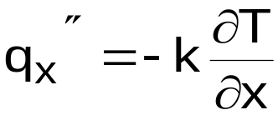
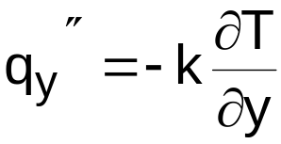
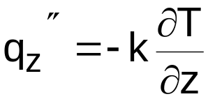
In Cartesian coordinates the general expression for q” is:
Where:
Thus, conduction heat transfer is based on Fourier’s Law, which is derived from the results of an experimental investigation. Fourier’s Law is a vector expression, and the heat flux is normal to an isothermal surface or isotherm. Fourier’s Law is applicable to all matter: gases, liquids and solids.

Slide 29
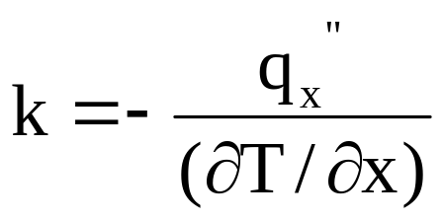
Thermal Properties of Materials
Thermal conductivity
Numerical value of the thermal conductivity indicates how fast heat will flow in a given material
Generally experimental methods may be used to determine the thermal conductivity for different materials
Analytical treatment in the kinetic theory of gases may be used at moderate temperature for gases
Theories are available for the prediction of thermal conductivities in liquids and solids (some cases)

Slide 30
For gases
The molecules have higher velocities in high temperature region than in low temperature region.
The molecules are in continuous random motion, colliding with one another and exchanging energy and momentum.
If a molecule moves from a high-temperature region to a region of a low-temperature, it transports kinetic energy to the low-temperature part of the system and gives up this energy through collisions with lower-energy molecules.

Slide 31
For liquids
The mechanism of thermal-energy conduction in liquids is qualitatively the same as in gases.
However, the situation is considerably more complex because the molecules are more closely spaced molecular force fields exert a strong influence on the energy exchange in the collision process.
For Solids
Thermal energy conducted in solids by (i). Lattice vibration and (ii). Transport by free electrons
Good electrical conductors are almost good heat conductors
Electrical insulators are usually good heat insulators
A notable exception is diamond – electrical insulator but k is more than 5 times as high as silver or copper

Slide 32
In general, the thermal conductivity is strongly temperature-dependent.
k_{solids} > k_{liquids} > k_{gases}

Slide 33
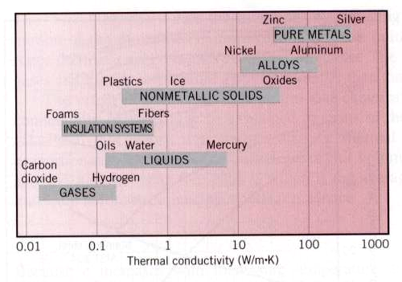
Thermal Properties of Materials
Range of thermal conductivity for various states of matter
at normal temperatures and pressure

Slide 34
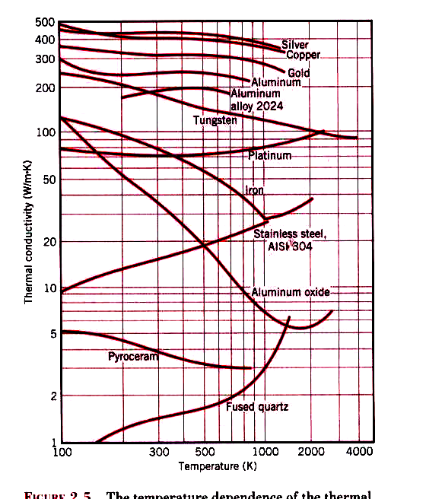
The temperature dependence of the thermal conductivity of selected solids

Slide 35
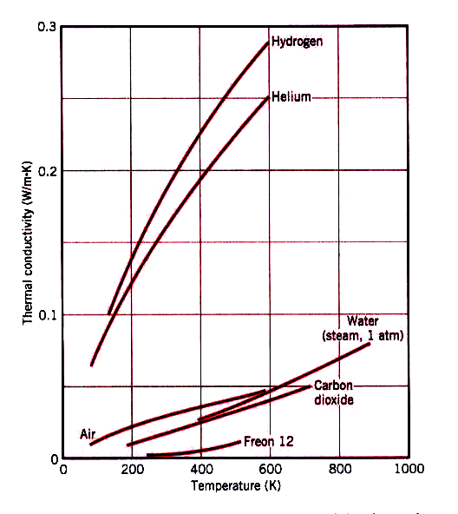
The temperature dependence of the thermal conductivity of selected gases at normal pressures

Slide 36
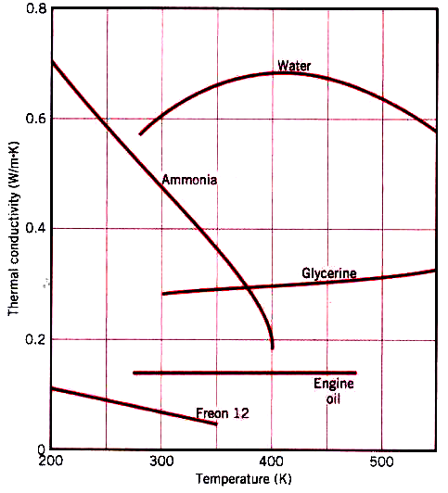
The temperature dependence of the thermal conductivity of selected nonmetallic liquids under saturated conditions

Slide 37
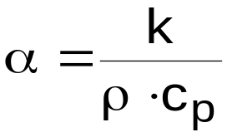
Other Important Thermophysical Properties
(i) Thermal Diffusivity α
Thermal diffusivity α is defined in terms of the transport property k (thermal conductivity) and volumetric heat capacity, ρ c_{p}:
    m²/s
    = Thermal Conductivity
    Volumetric Heat Capacity
    C_{p} = Specific heat (J / kg K) ρ = Density (kg/m³)
(ii) Kinematic Viscosity, ν
Kinematic viscosity is another transport property and the units of ν are also m²/s as in α, and it is an important property in momentum transfer.

Slide 38




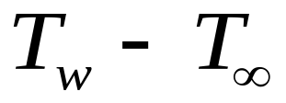
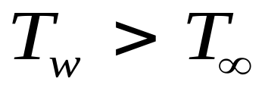
Heated Wall at
Thermal Boundary Layer
Thermal boundary layers are also thin.
The velocity and thermal boundary layers
are not generally equal.

